Slide 1
Deployment Management
Lecturer: Ngo Huy Bien
Software Engineering Department
Faculty of Information Technology
VNUHCM - University of Science
Ho Chi Minh City, Vietnam
nhbien@fit.hcmus.edu.vn

Slide 2

Objectives
To implement continuous delivery.

Slide 3

Contents

Slide 4

References
Julien Vehent (2018). Securing DevOps. Manning Publications.
Yevgeniy Brikman (2025). Fundamentals of DevOps and Software Delivery. O'Reilly Media.

Slide 5
What is DevOps? [1]
DevOps is the process of continuously improving software products through rapid release cycles, global automation of integration and delivery pipelines, and close collaboration between teams.
The goal of DevOps is to shorten the time and reduce the cost of transforming an idea into a product that customers use.
DevOps makes heavy use of automated processes to speed up development and deployment.

Slide 6
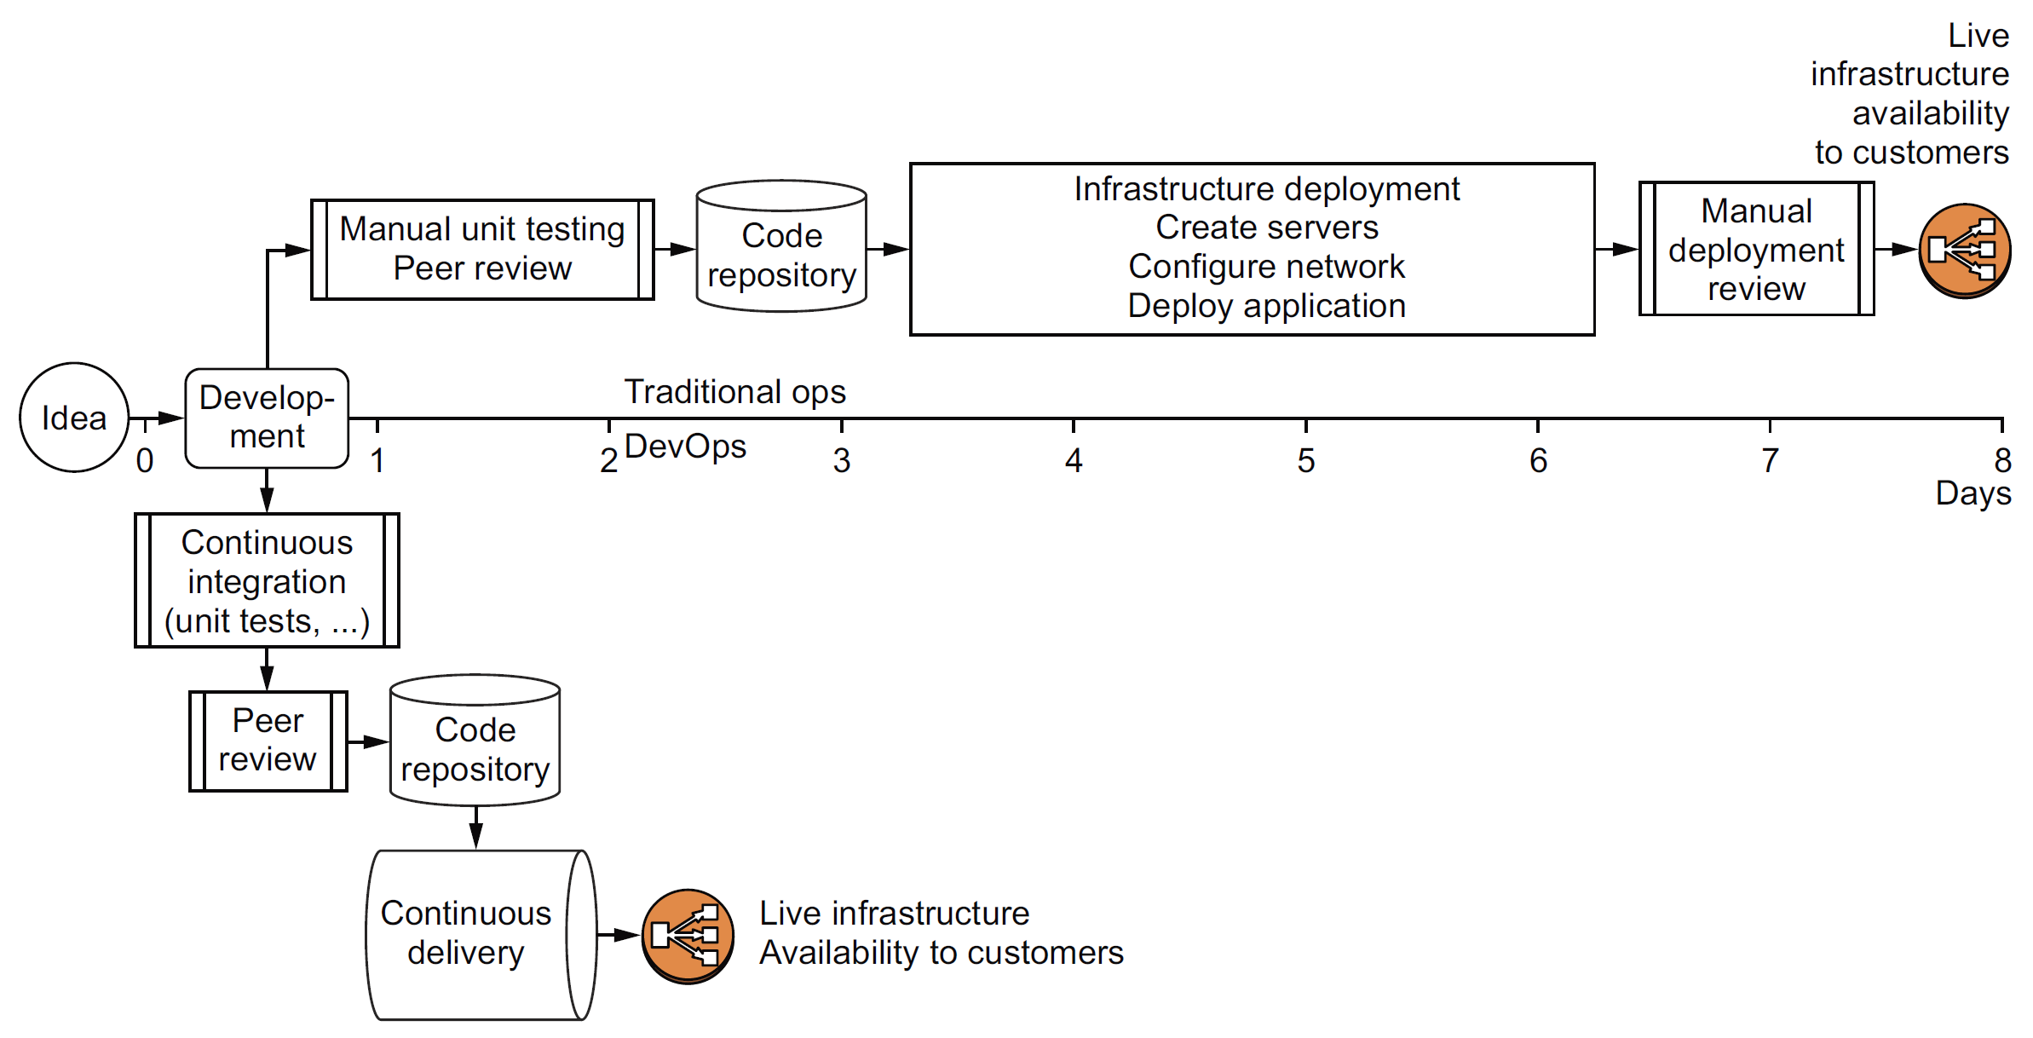
Traditional Software-building Approach vs. DevOps
8 days vs. 2 days.
With DevOps, developers can release new versions of their software, test them, and deploy them to customers in as little as a few hours. That doesn’t mean versions are always released that quickly, and it can take time to do proper quality assurance (QA), but DevOps provides the ability to move quickly if needed.

Slide 7
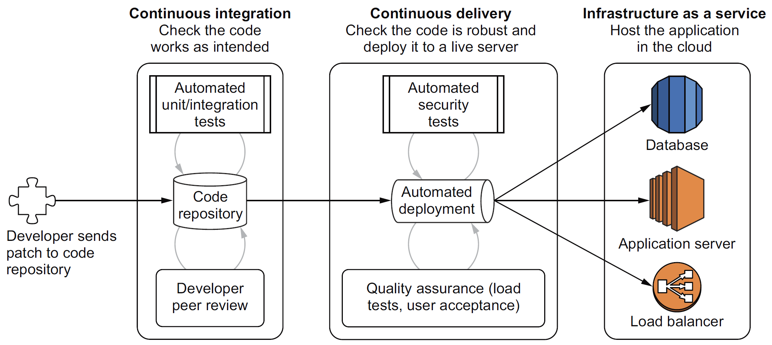
The Key Components
Continuous integration (CI), continuous delivery (CD), and infrastructure as a service (IaaS) form an automated pipeline that allows DevOps to speed up the process of testing and deploying software.

Slide 8
Deploy an App via PaaS (Render)

Slide 9
Deploy an App via IaaS (AWS)

Slide 10
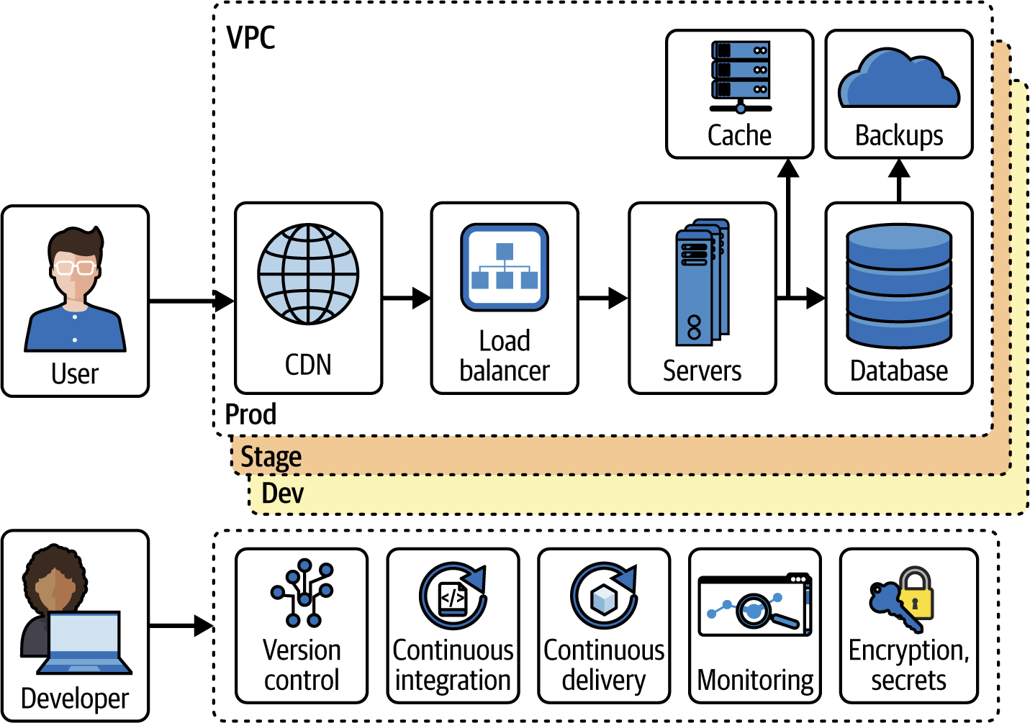
DevOps (I) [2]

Slide 11
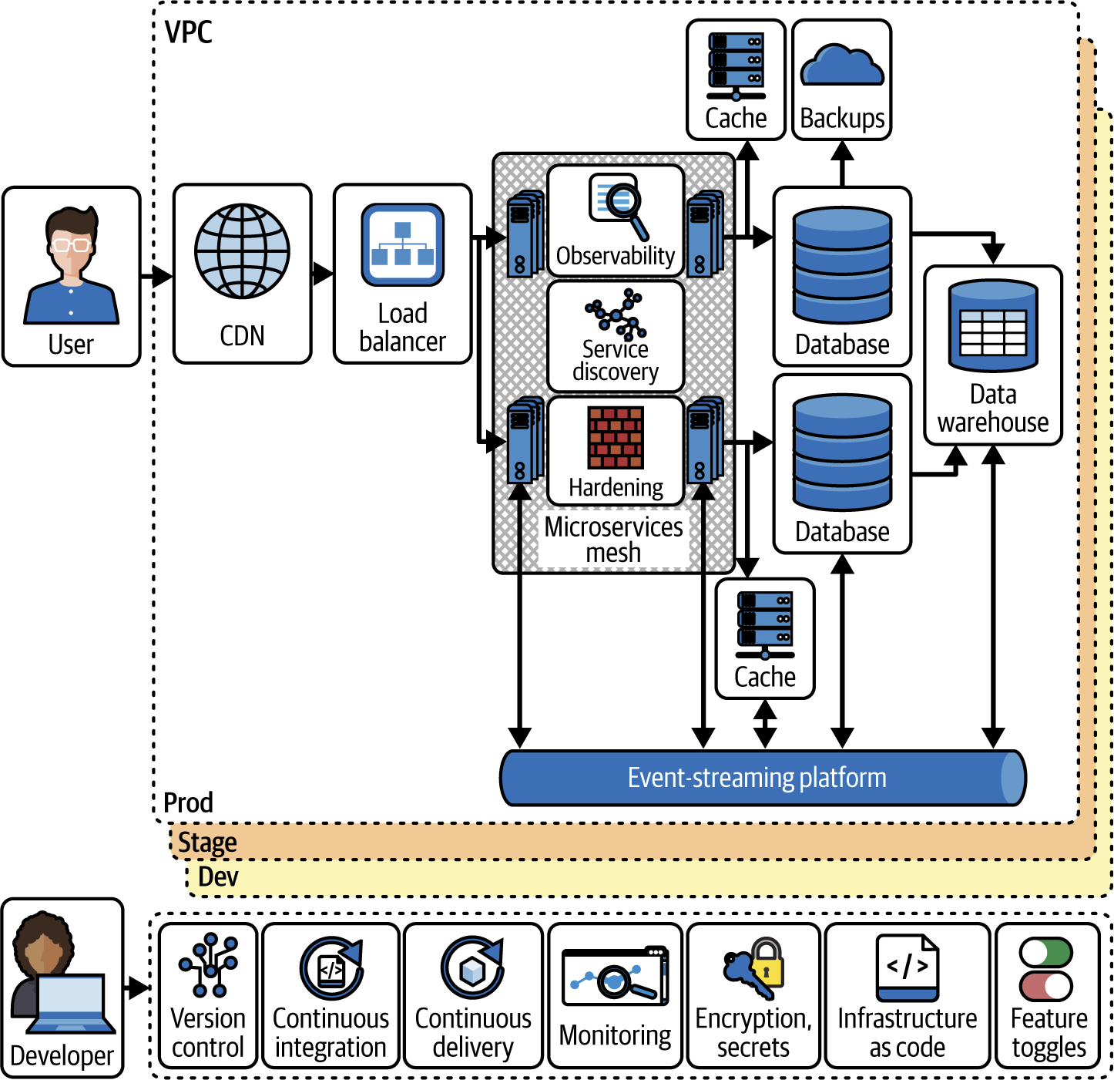
DevOps (II)

Slide 12
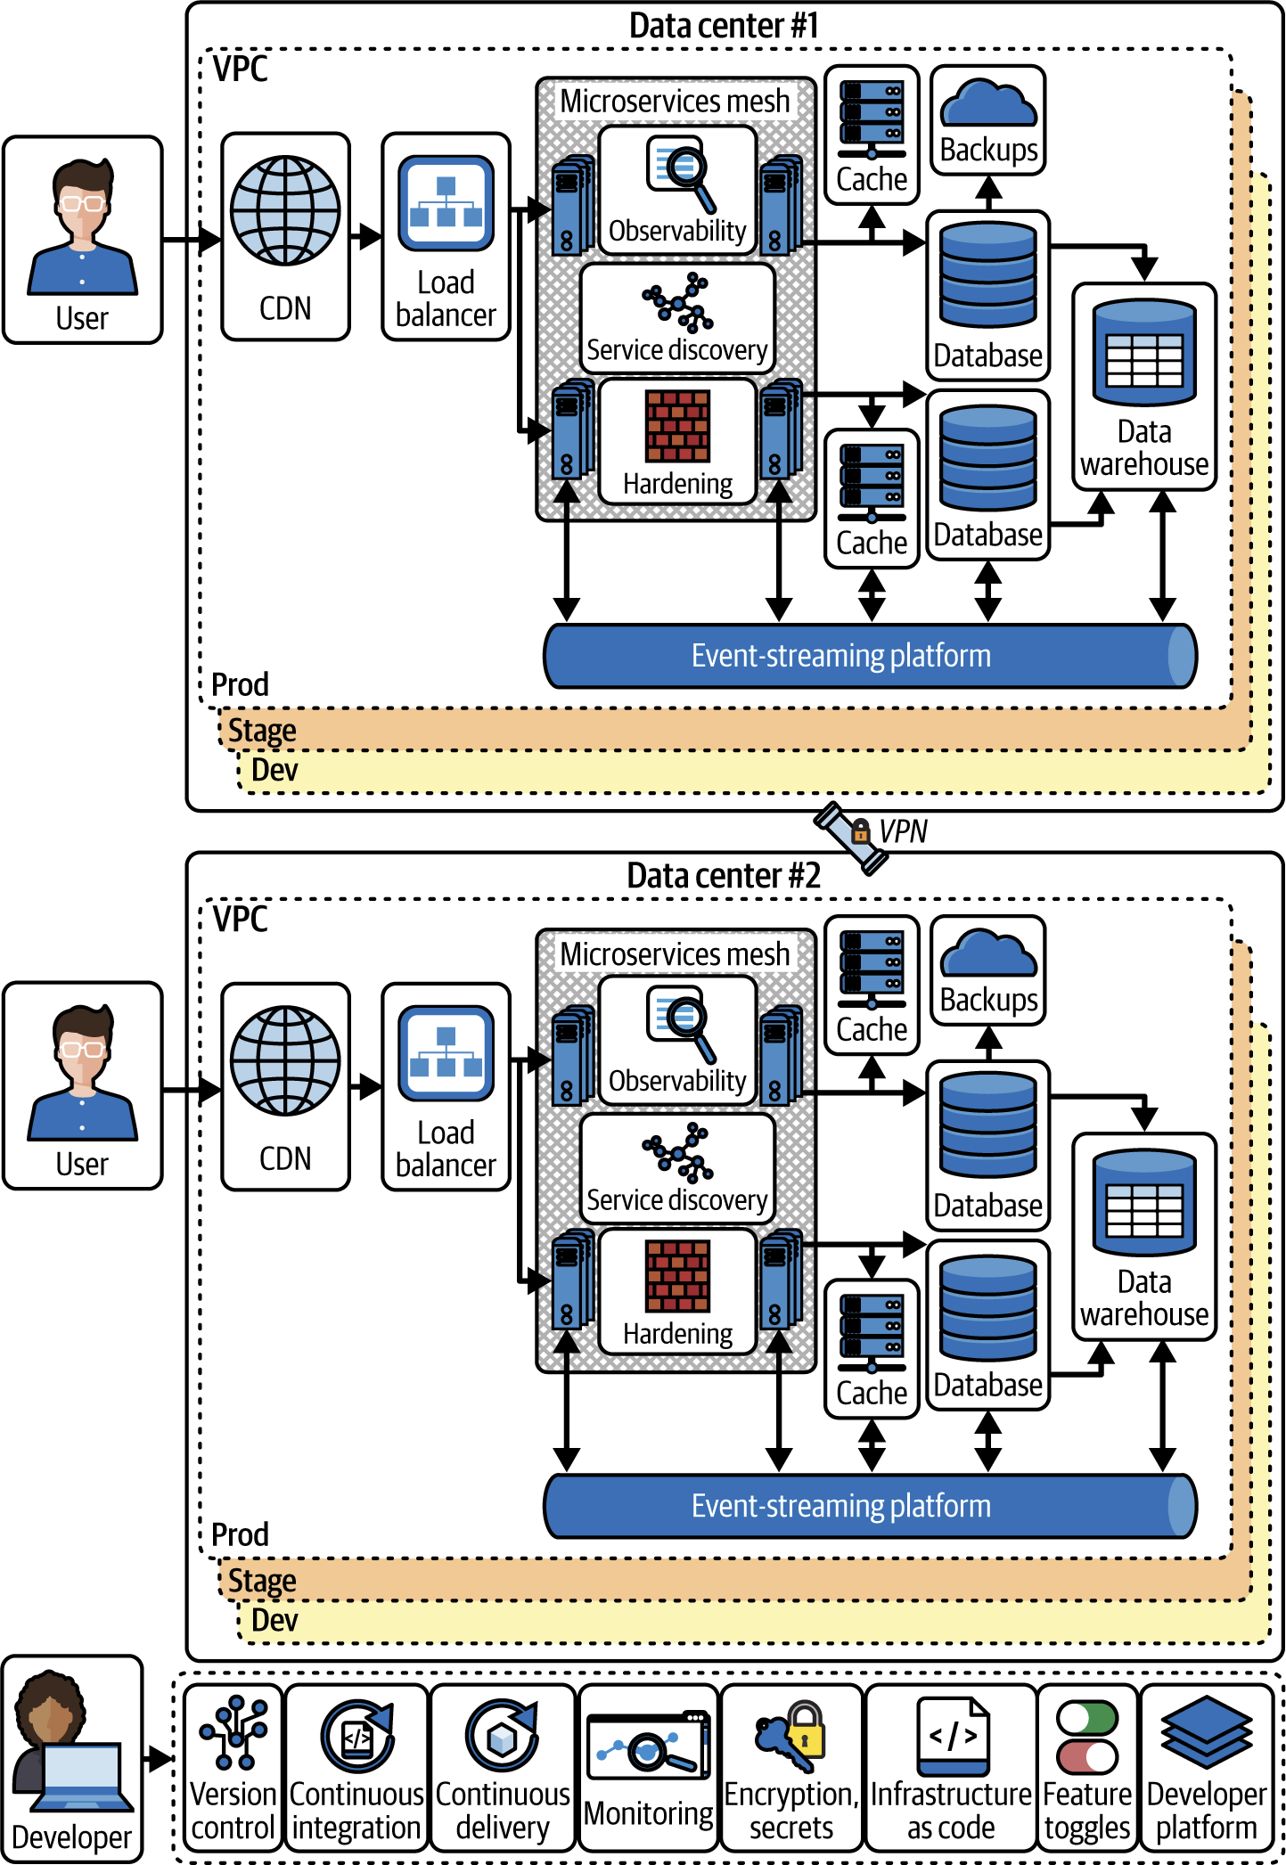
DevOps (III)

Slide 13
Code
https://github.com/brikis98/devops-book

Slide 14

Thank You & See You Again

